Slide 1

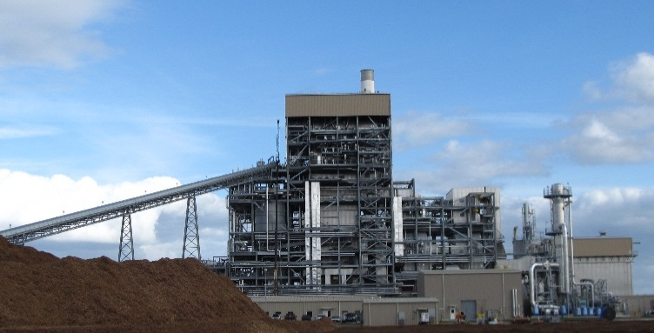
The Development and Construction of a 100 MW Biomass Power Plant
Gainesville, Florida
A project overview by
Leonard Fagan
Vice President of Engineering
Energy Management, Inc.

Slide 2



Ownership Structure
GREC is a limited partnership between:
and
Fagen Principals

Slide 3
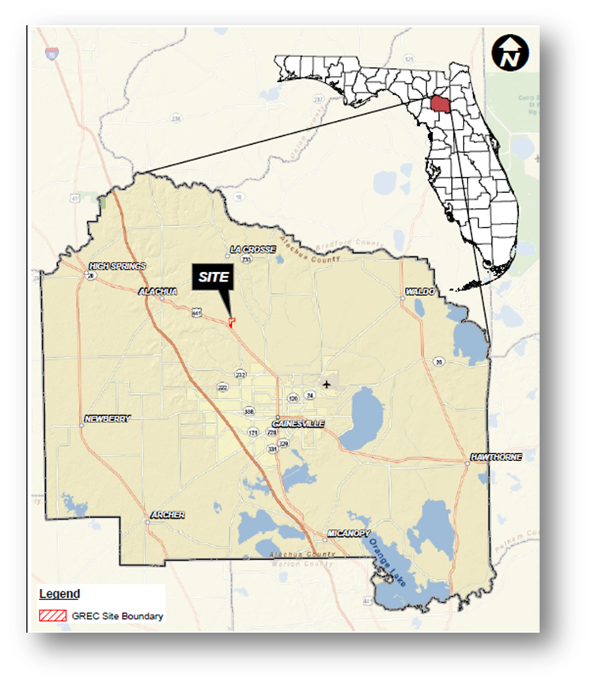
Project Description
100 MW biomass-fired generating facility
  Metso HYBEXTM Bubbling Fluidized Bed (BFB) boiler will combust wood waste fuel to produce superheated steam
Primary fuels are wood and wood waste
  Forest, mill, and agricultural residues; waste pallets;
  urban wood waste; thinning's; slash; and storm debris
  Efficient and clean design
  Low heat rate due to advanced boiler design and steam cycle
  Low emissions through clean combustion process
    SCR to reduce NO_{x} emissions
    Baghouse to reduce particulate emissions
    Sorbent injection for acid gas reduction
Located in Gainesville, Florida
  Well-positioned to capture fuel resource from north central Florida wood basket, as well as urban wood waste in region
  Co-located with existing coal facility
  Utilizing groundwater and reclaimed water for process water needs

Slide 4
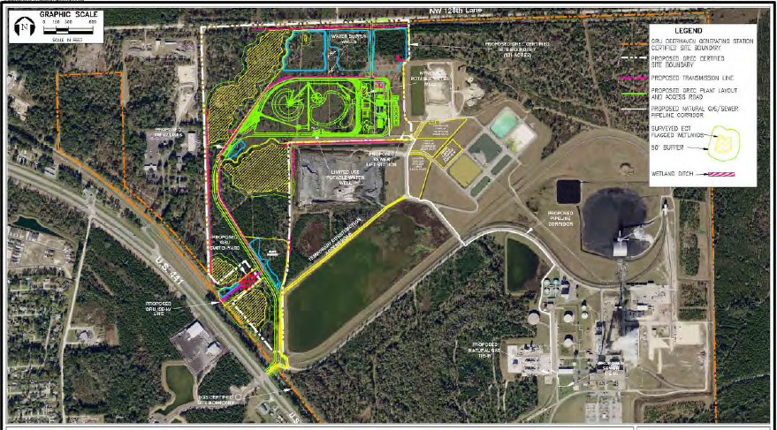
Overall Layout

Slide 5
History & Schedule
Date | Description
December 2006 | Submitted letter of interest to GRU in response to RFI
December 2007 | Submitted proposal to GRU in response to RFP
January 2008 | Invited by Gainesville City Commission to submit final proposal
April 2008 | Submitted final proposal to GRU
May 2008 | Awarded right to solely negotiate power purchase agreement (PPA) with GRU
April 2009 | Executed 30-year PPA with GRU
September 2009 | Executed long-term lease with City of Gainesville for 131-acre parcel adjacent to coal plant

Slide 6
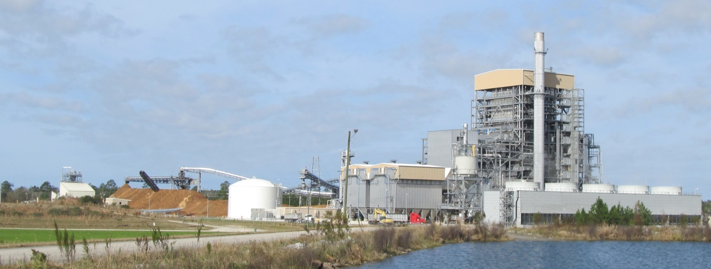
Development Timeline
  May 2009 Initiated preliminary design & permitting
  December 2010 Final permit approval from FDEP
  March 2011 Construction start date with LNTP
  June 30, 2011 Financial closing and FNTP
  October 16, 2013 Achieved Substantial Completion
  December 17, 2013 Began Commercial Operation

Slide 7
Milestones
Milestone | Completion Date
Boiler Hydro | February 21, 2013
First Fuel Delivery | April 3, 2013
Start of Sustained Wood Delivery | June 10, 2013
Chemical Clean | June 18, 2013
First Fire – Natural Gas | July 7, 2013
First Fire – Biomass | July 8, 2013
Steam Blows & Restoration | July 22, 2013
First Sync to Grid | August 16, 2013
Full Load Operation | August 20, 2013
Substantial Completion | October 16, 2013
Performance Tests | November 23, 2013
Commercial Operation | December 17, 2013

Slide 8




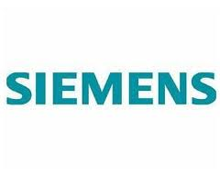



Key Partners
Fagen, Inc. EPC Contractor
Zachry Engineering
Metso BFB Boiler
Metso Automation DCS
Clyde Bergemann Bag House & DSI
Siemens Steam Turbine
Wolf Material Handling Wood yard design & Supply
Aquatech Water Treatment (demin & ZLD)
Trace Environmental CEMS
Flowserve Major pumps

Slide 9
Design Concepts
102.5 MW Net (116.1 MW Gross)
High Availability
20 Days Fuel Supply
Low Heat Rate
Utility Quality
Zero Liquid Discharge Site
138-kV Interconnect

Slide 10
Cycle Design
1620 psig 1005ºF superheater outlet
4 STG bleeds for feed water heating
440ºF feed water to economizer
2.4 in hg abs design condenser vacuum
Fuel moisture 50% design, 45% guarantee, 41% average
Optimized auxiliary power
Low net heat rate

Slide 11
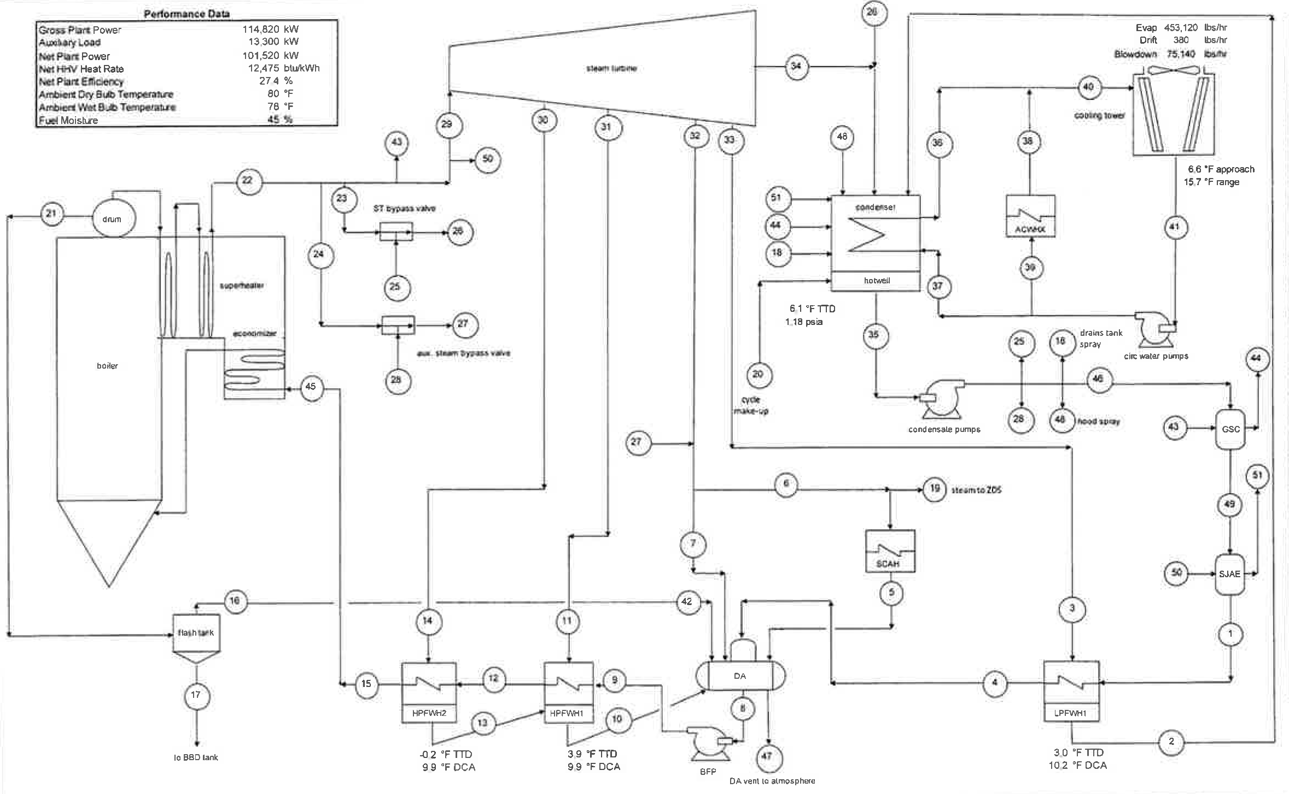
Heat Balance

Slide 12

Metso Boiler
Bubbling fluidized bed boiler
930,000 pph, 1,620 psig/1005 º F designed for 50% moisture fuel
Similar to Nacogdoches design through economizer
Natural gas start up burners
Hot baghouse (450ºF operational temperature)
Sorbent injection using Sodium Bicarbonate
Low dust SCR Catalyst by Ceram
Metso provided design, supply and erection of boiler island

Slide 13
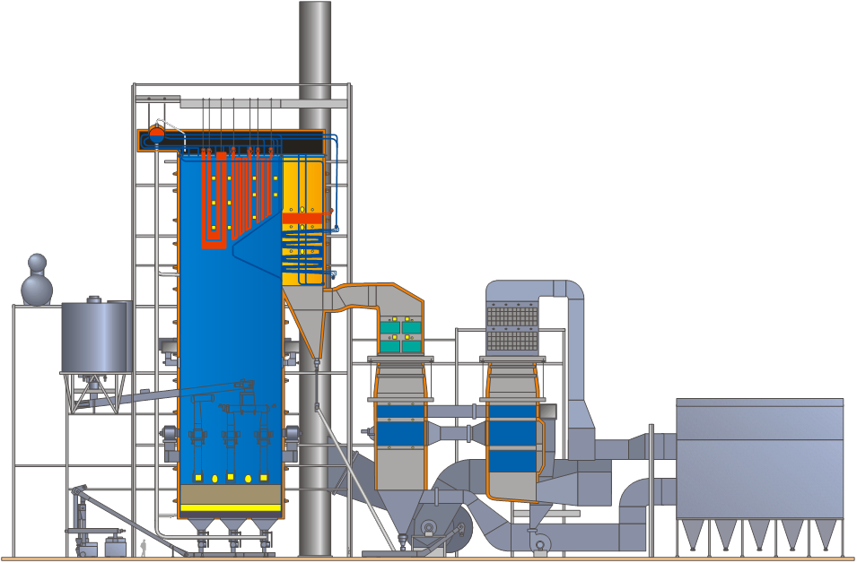
Project Description
Metso HYBEX boiler
Bubbling Fluidized Bed (BFB) technology
Steam: 292 MW_{th} (100 MWe) 930,000 lbs/hr
1645 psi
1005 °F
Boiler: Similar to Nacogdoches design
  Stainless finishing superheater Hydrobeam bottom

Slide 14
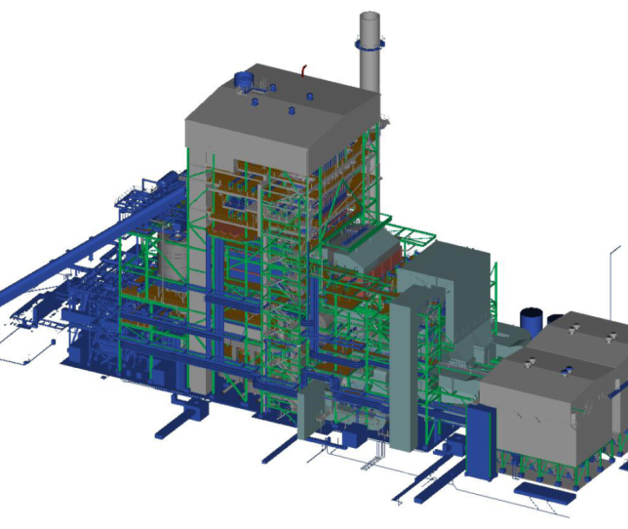
Project Description
GREC: World’s largest BFB with
lowest flue gas emissions
Fulfills EPA’s most recent flue gas emission limits
SCR for NO_{x} emissions
Baghouse filters with dry sorbent feeding

Slide 15
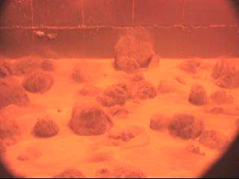
Fluidization

Slide 16

Siemens Steam Turbine
SST900 condensing steam turbine generator
Made in Finspong, Sweden
1,575 psig 1,000º F rated at 116.1 MW
Axial exhaust condensing at 2.4 in Hg Abs
4 heater bleeds
Brush 136.6 MVA, 13.8 kV TEWAC generator

Slide 17
Plant Control
DCS – Metso Automation DNA
BFB Boiler monitoring and control
HIMA integrated into DCS for start-up burners
BOP
Advanced boiler controls optimization
AGC
Coordinated control
Training simulator
Wood yard PLC with control room HMI
Siemens STG PLC
Aquatech water treatment PLC
CEMS PLC with computer in control room

Slide 18
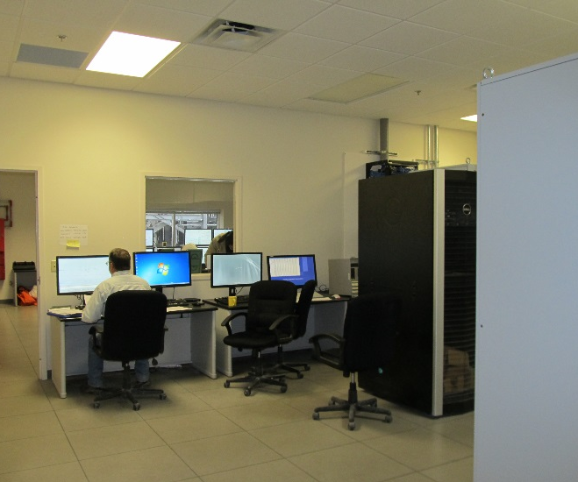
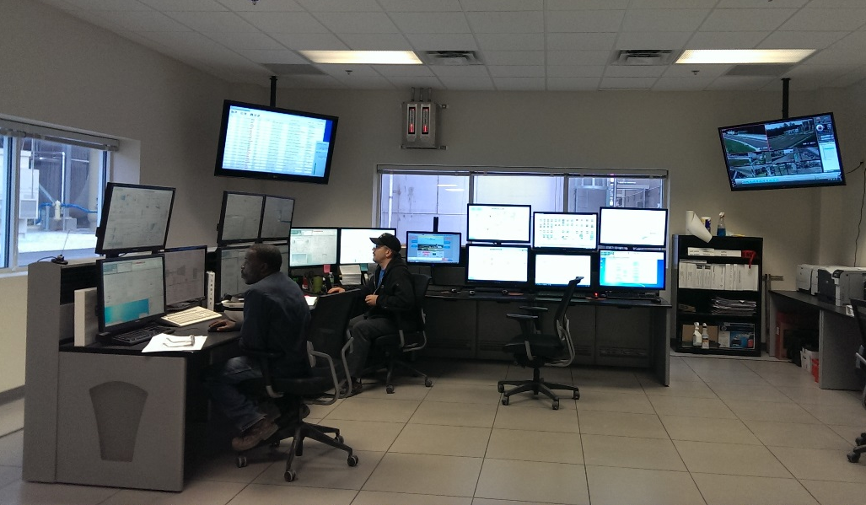
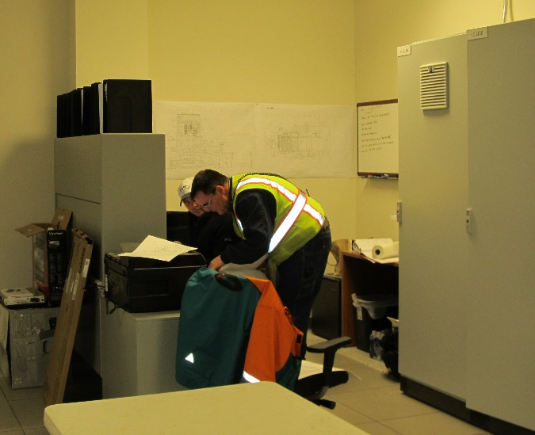
Control & DCS Rooms

Slide 19
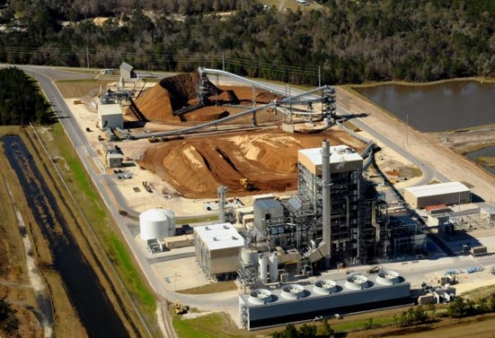
Aerial View

Slide 20
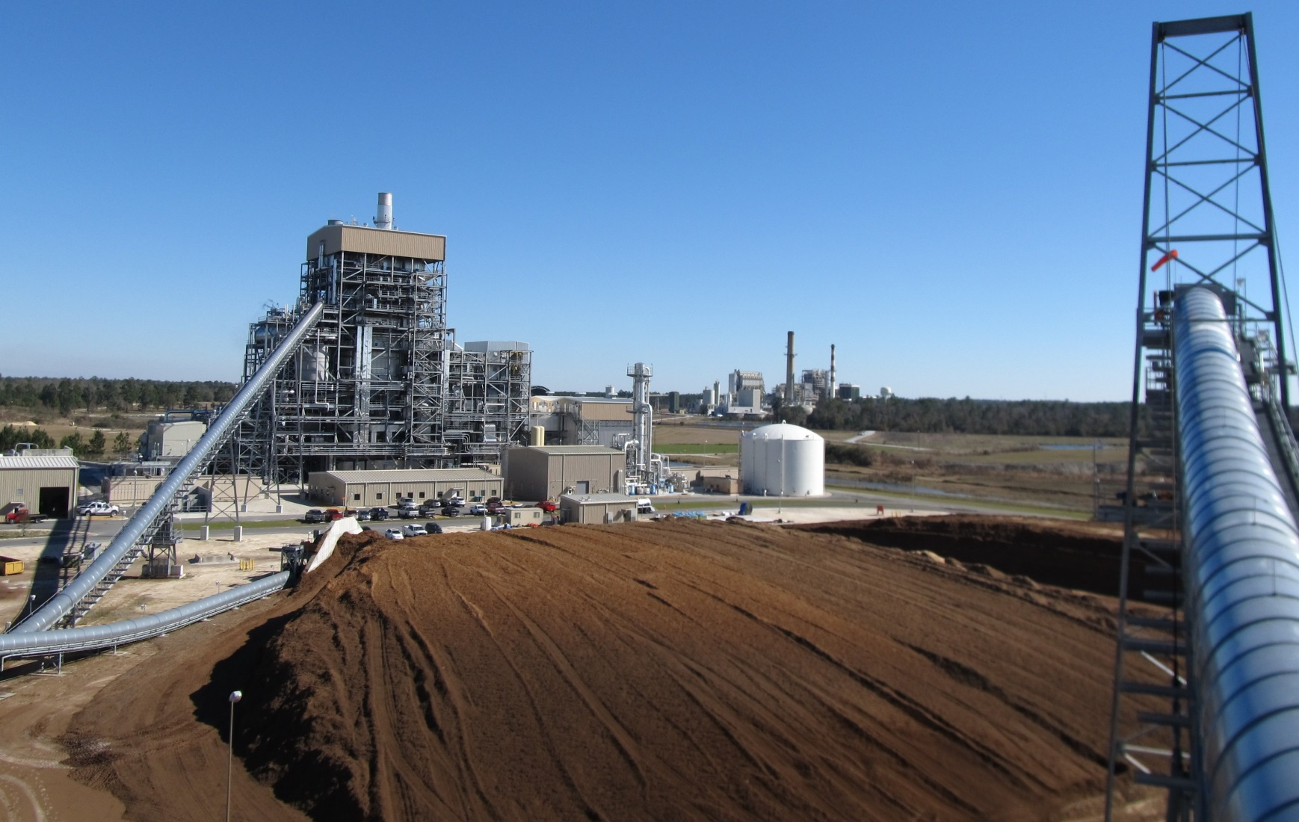
View from West

Slide 21
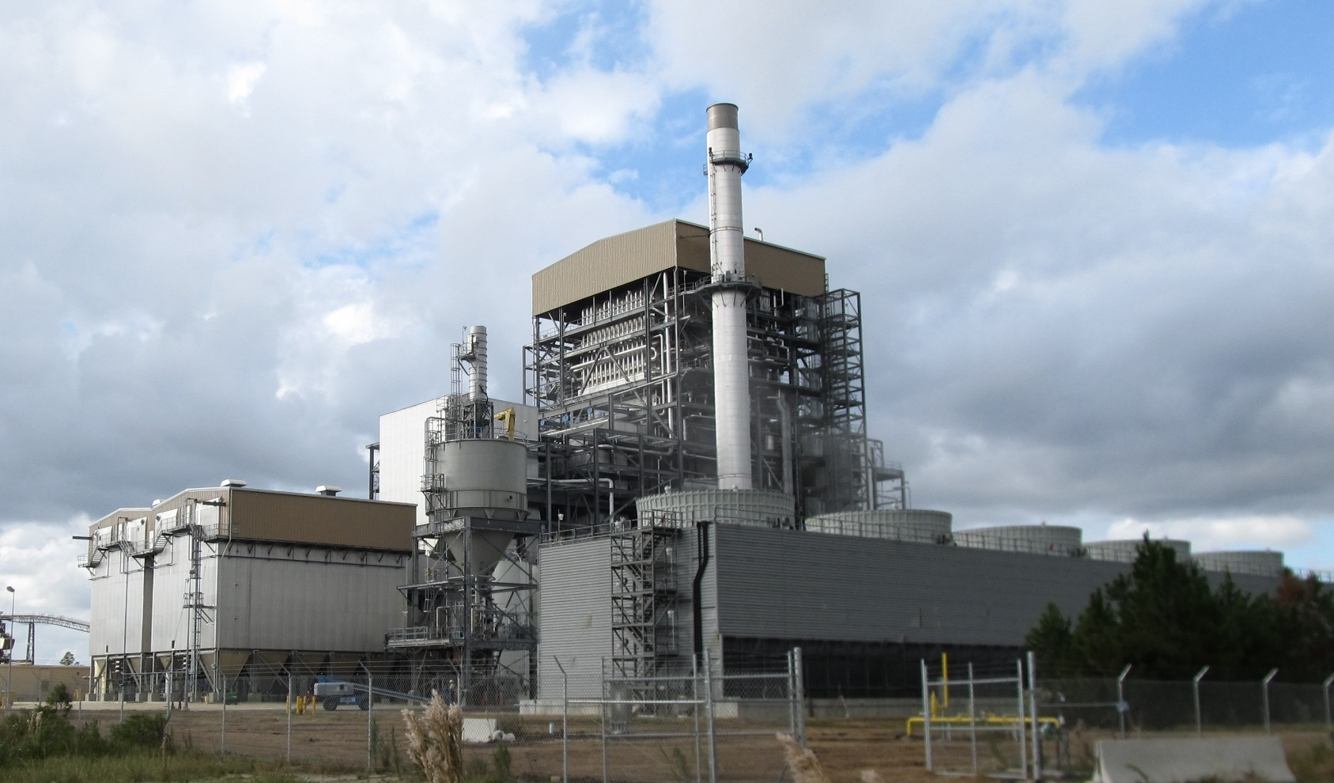
View from SE

Slide 22
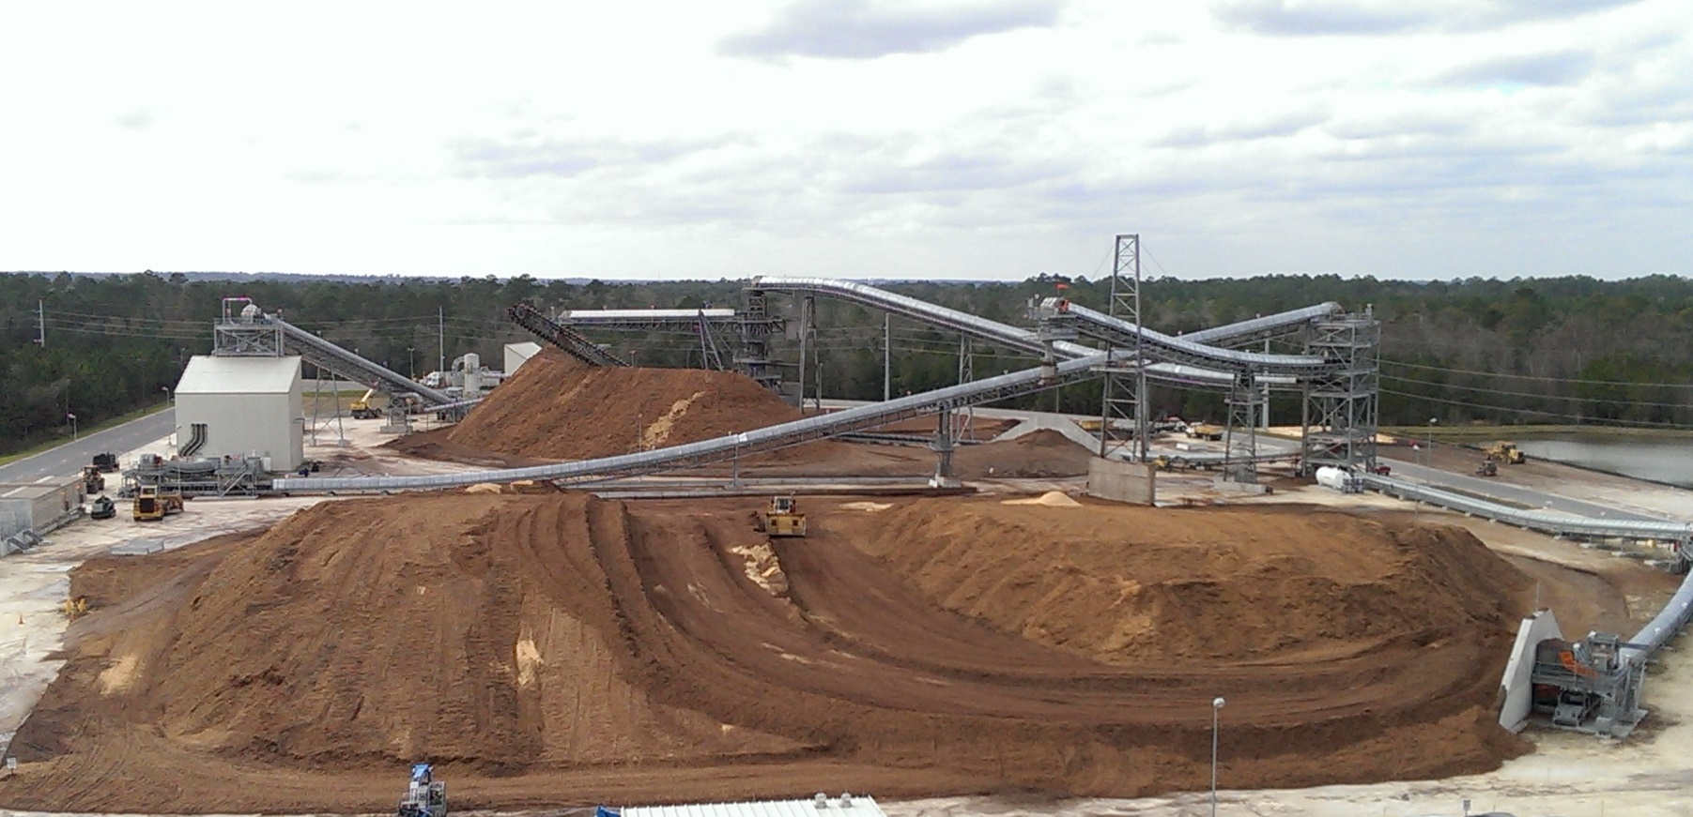
View of Wood Yard

Slide 23

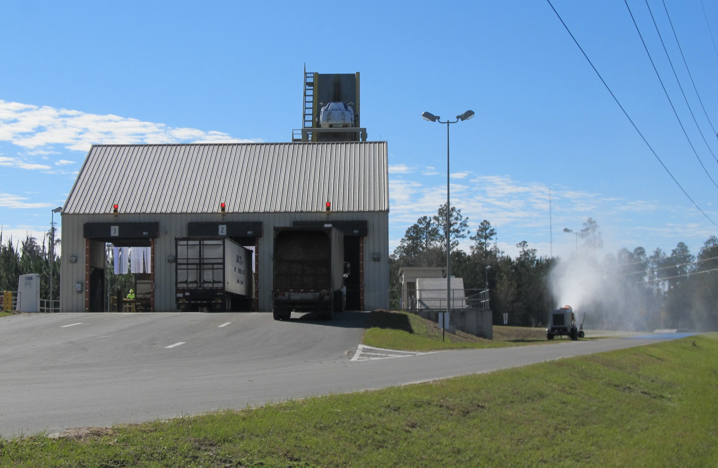
Truck Tippers

Slide 24
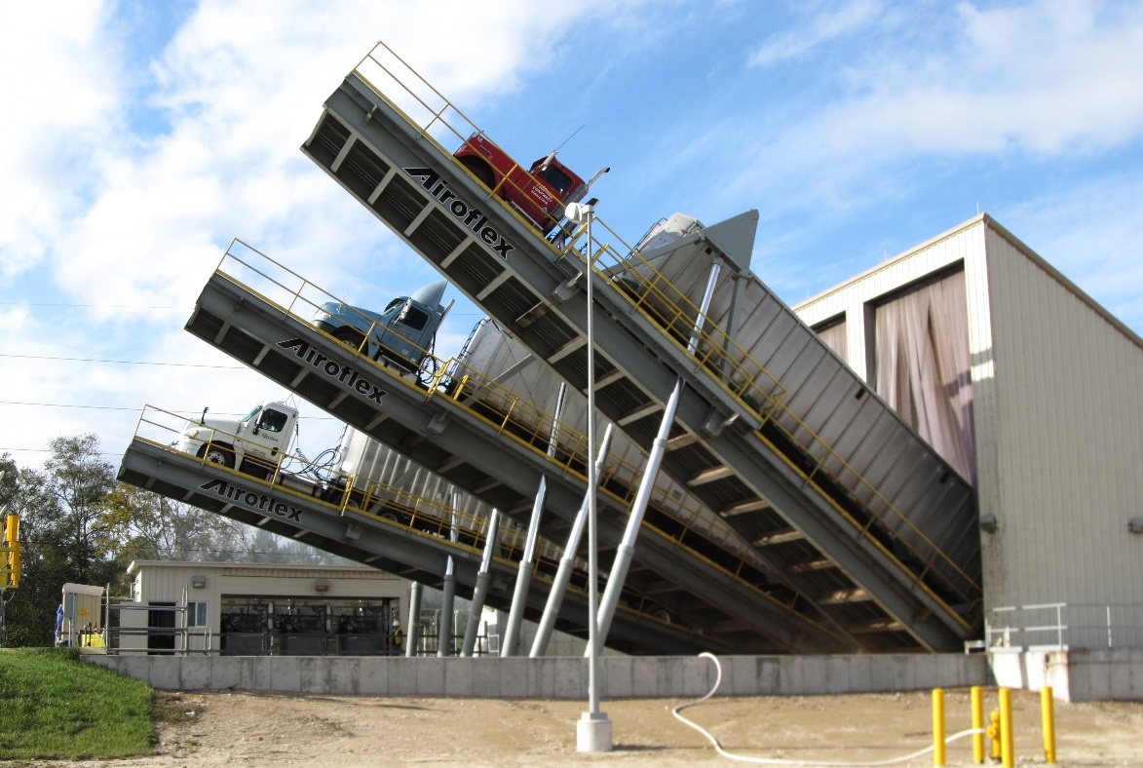
Trucks Tipping

Slide 25
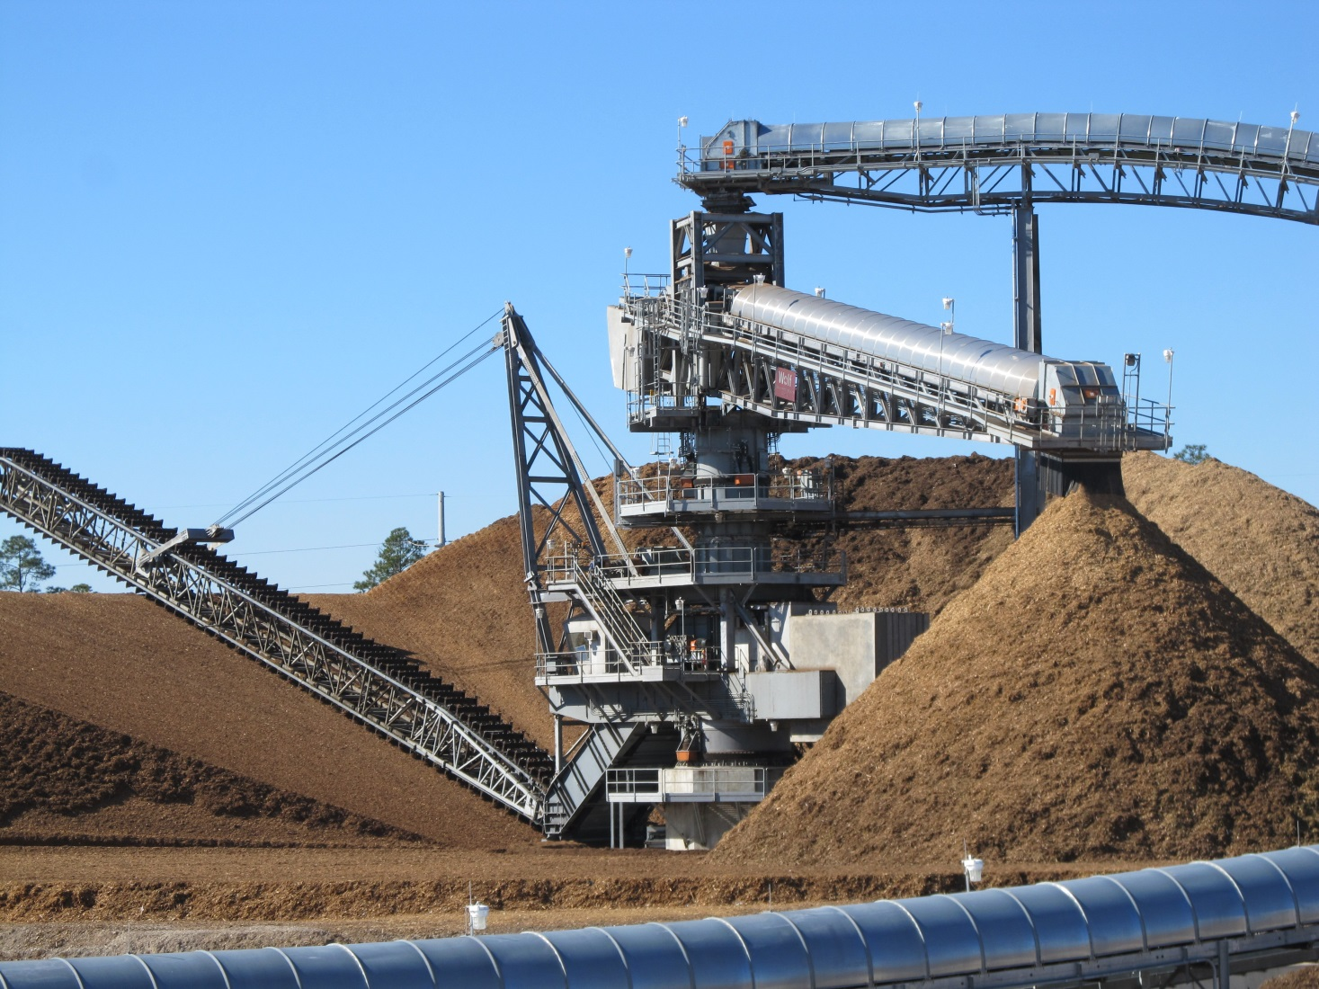
Stacker Reclaimer

Slide 26
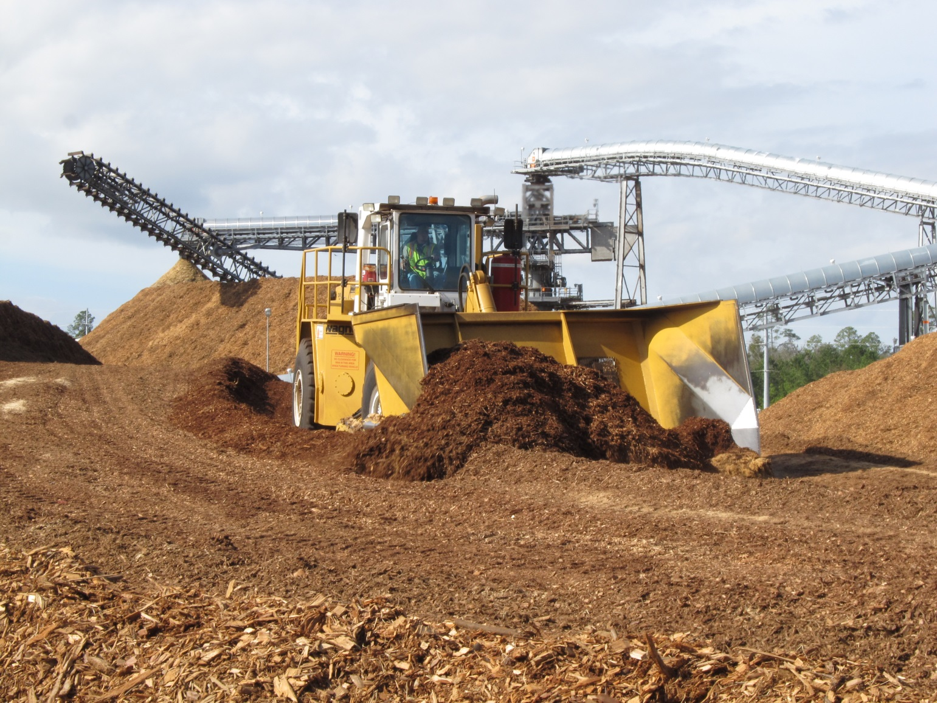
Wagner at Work

Slide 27
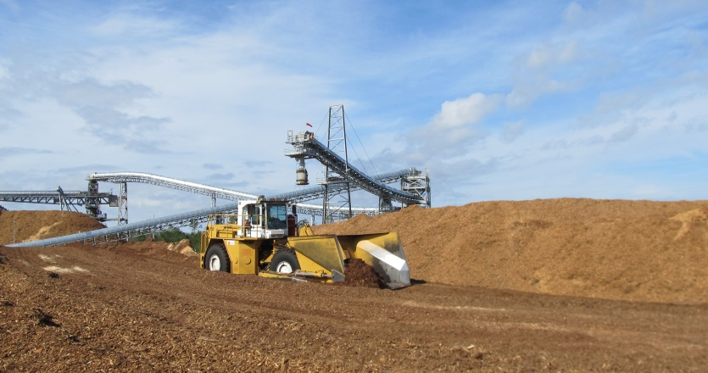
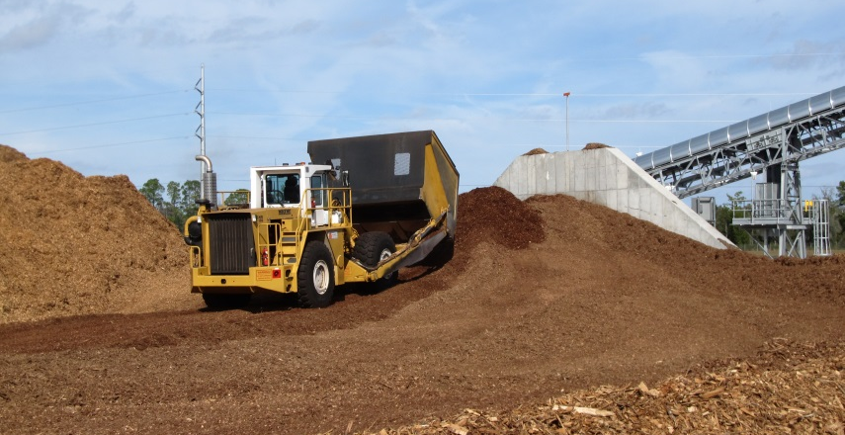
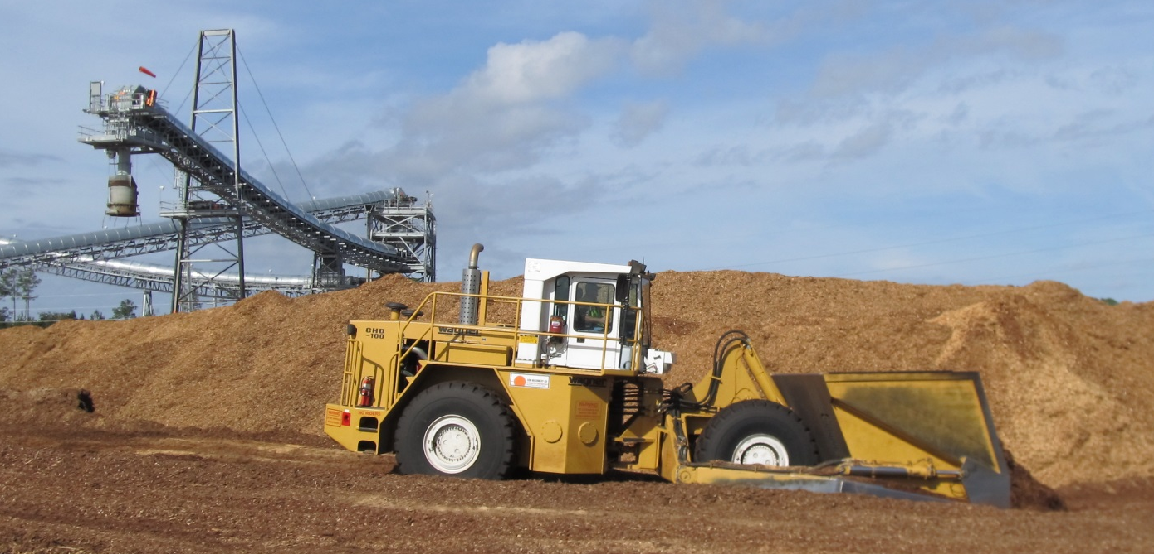
Wagner at Work

Slide 28
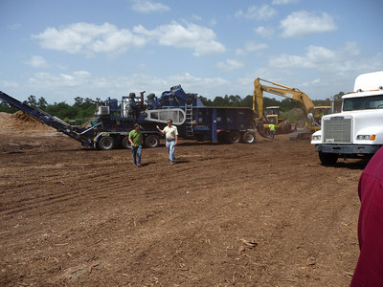
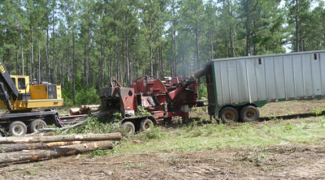
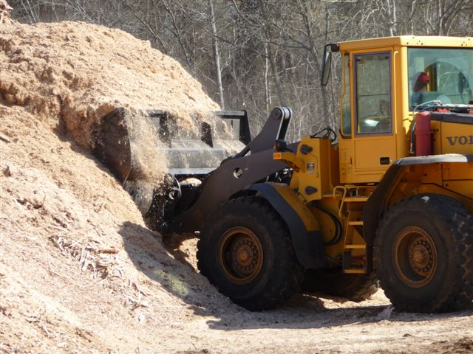
Fuel Sources
GREC will need approximately 1 million green tons of biomass fuel per year
Urban Wood
  Clean wood waste consisting of urban tree debris from tree surgeons, municipal brush, pallets
  No construction and demolition debris or municipal solid waste will be utilized
Forest Biomass
  Low-value trees, tree tops, and branches remaining after commercial tree harvest and land clearing
Mill Residues
  Residues from primary and secondary wood processing (bark, saw dust, shavings, scraps, and wood chips)

Slide 29

O & M
GREC has subcontracted to NAES Corporation to operate and maintain the plant on a 24/7 basis. NAES has 41 full-time employees working at GREC.
Lead Control Room Operator (4)
Operations Supervisor
Steven Marsh
Plant Manager
Russell Abel
Maintenance Supervisor
Tommy Gardner
Administrative Assistant
Maintenance Planner
Maintenance Technician
(4)
IC&E Technician (3)
Water Treatment Operator (4)
Auxiliary Plant Operator
(8)
Fuel Yard Operator (10)
Plant Engineer
Ali Leaphart
Warehouse Technician
Office Supervisor
Lorie Thebaut

Slide 30

Fuel Procurement
GREC has subcontracted to BioResource Management, Inc. (BRM) to manage fuel procurement and ensure forest sustainability standards are met.
BRM is a Gainesville-based consulting firm that specializes in biomass supply services
BRM has 4 full-time employees on site: Biomass Procurement Manager, Quality Control Manager, Accounts Manager and Field Forester

Slide 31
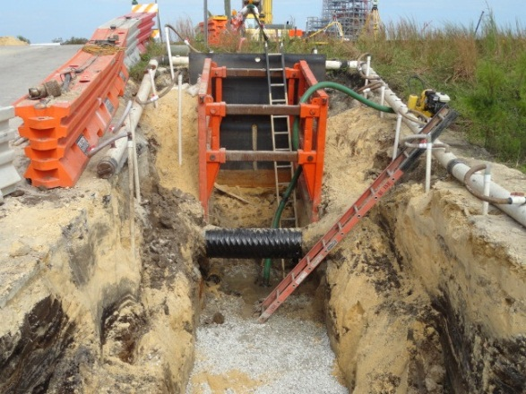
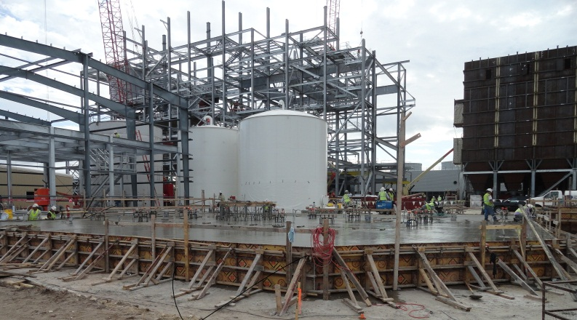
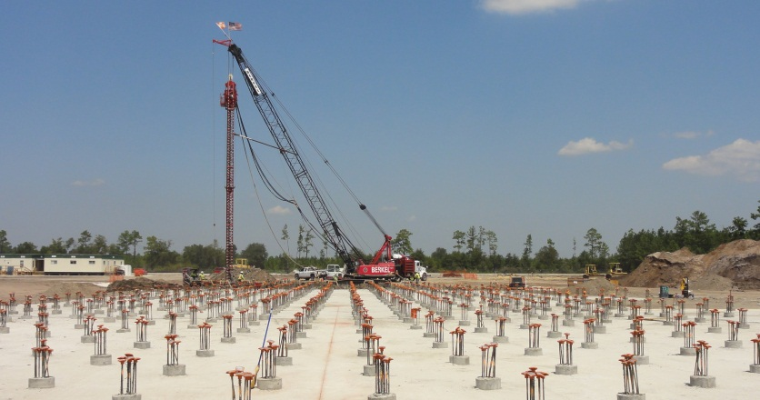
Construction Challenges
High water table
Extensive dewatering
1200 augur cast piles
Average grade build-up of 3 feet

Slide 32
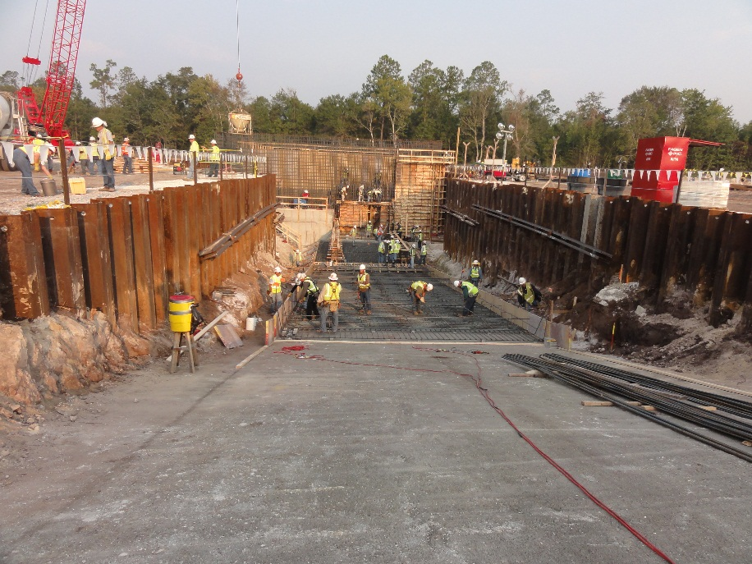
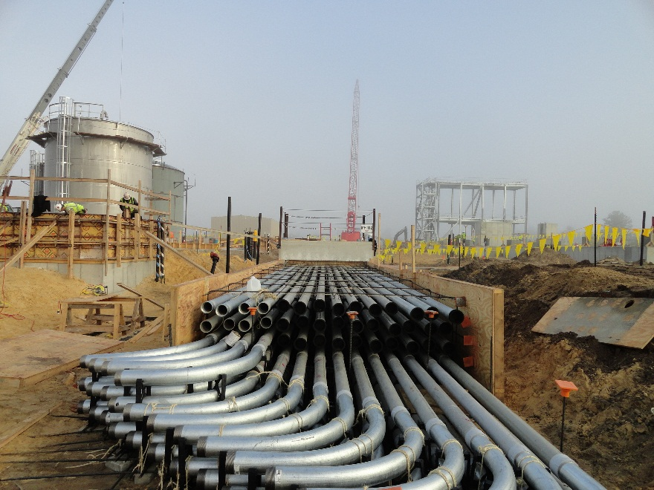
Early Construction
Conveyor Tunnel Rebar – Sept 2011
Conduit Installation – Oct 2011

Slide 33
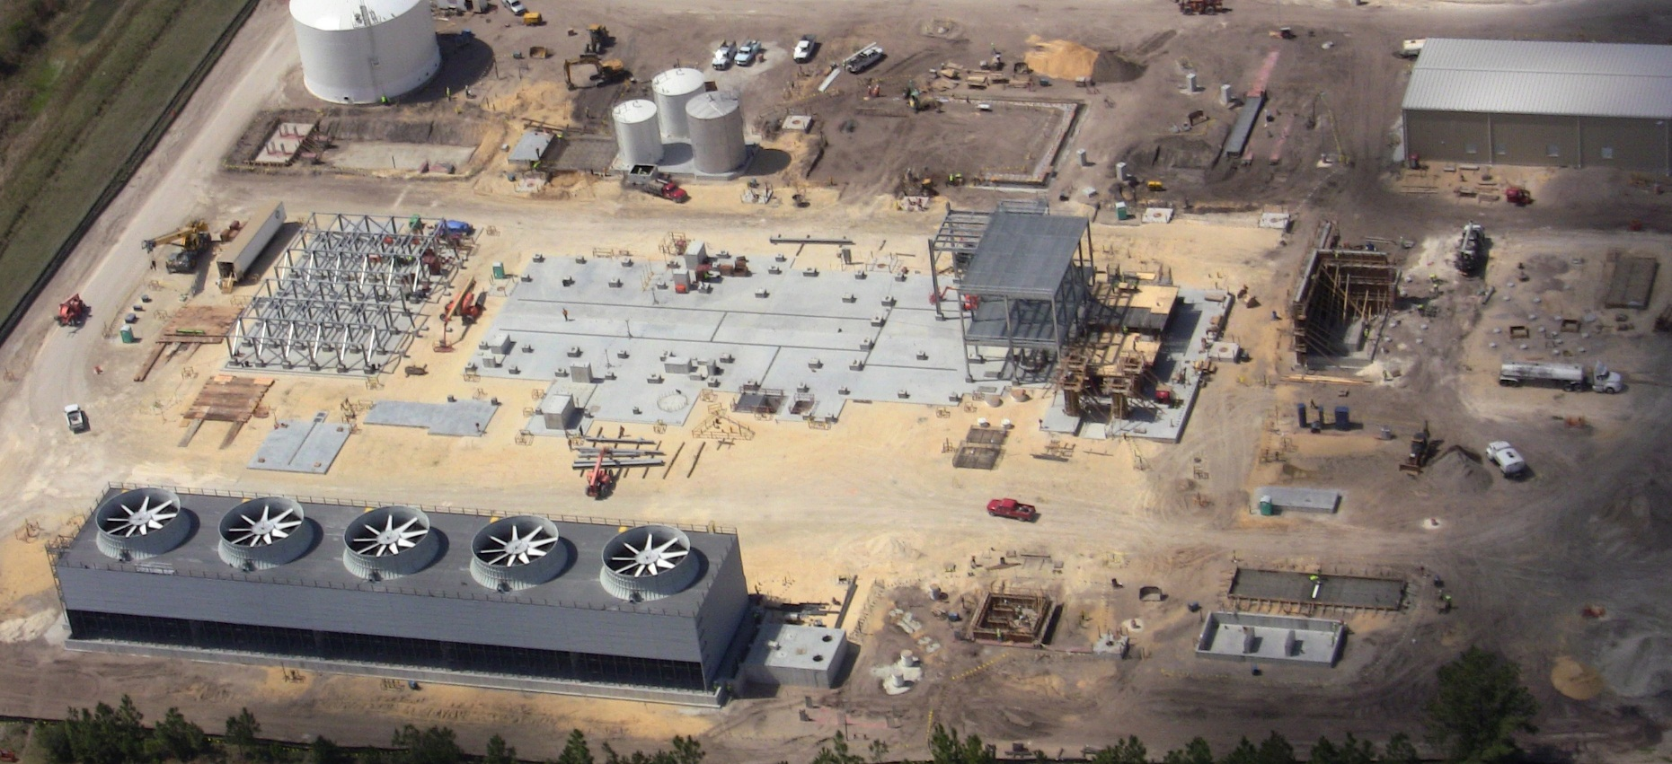
Early Construction
Aerial View – March 2012

Slide 34
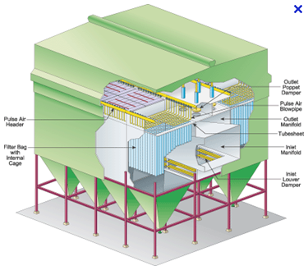
Emissions Challenges
Low Dust SCR for NOx Control (hot bag house)
Sorbent injection for HCl, HF and SAM (sodium bicarbonate)
Low levels of HCl and HF pushing measuring limits
IB MACT addition of Hg and low PM

Slide 35
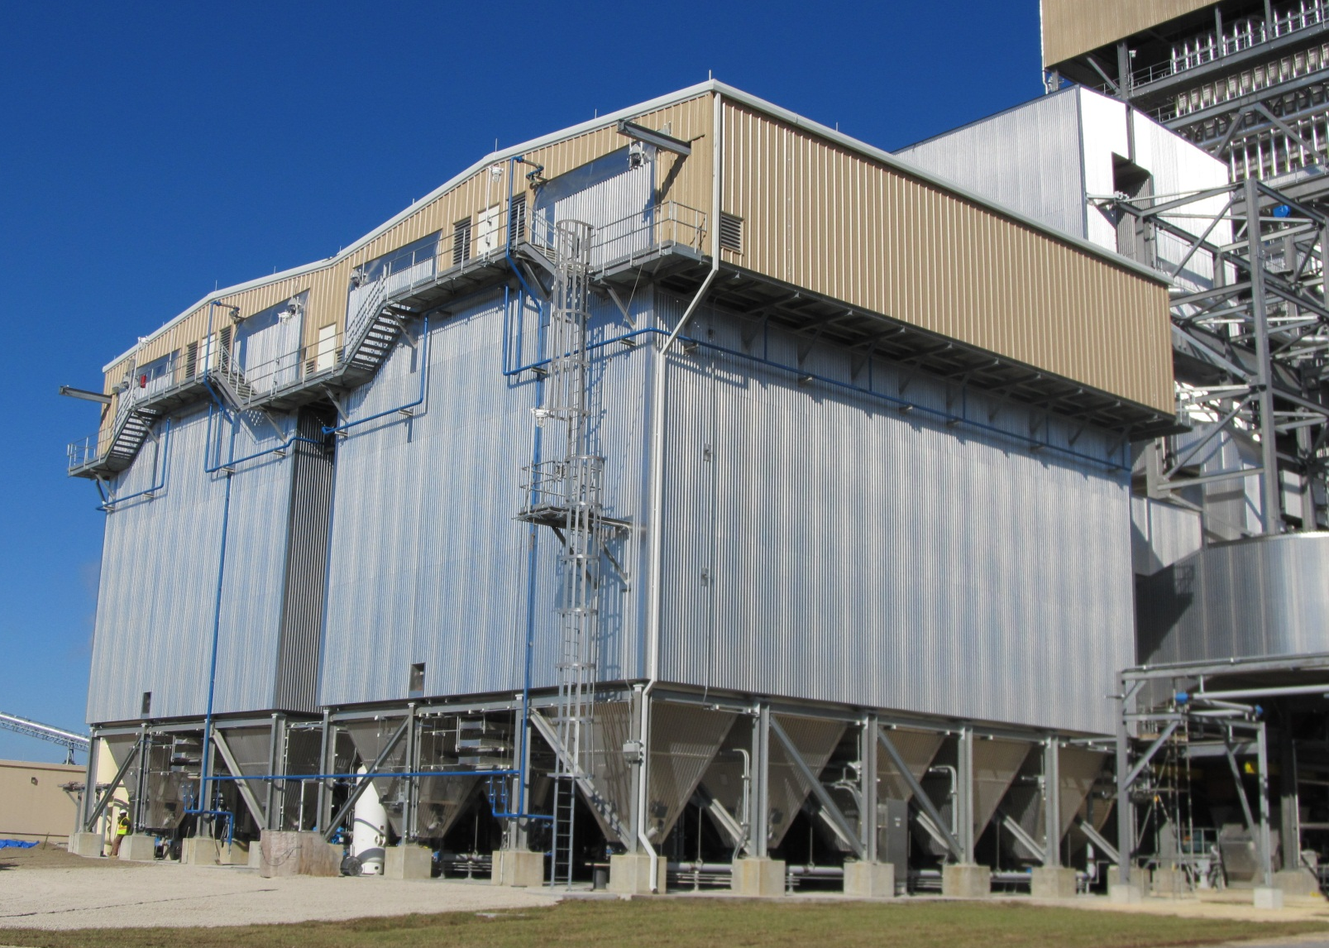
View of Baghouse

Slide 36
Zero Discharge Site
Boiler blowdown, RO & filter backwash & miscellaneous sumps to cooling tower basin
Cooling tower blowdown to 80,000-gallon waste water tank
Aquatech ZLD system design and supply
Vertical tube falling film evaporator sized for 165 gpm
Forced circulation crystallizer
Distillate back to process water system
Crystallizer belt filter press
Salt cake to landfill

Slide 37
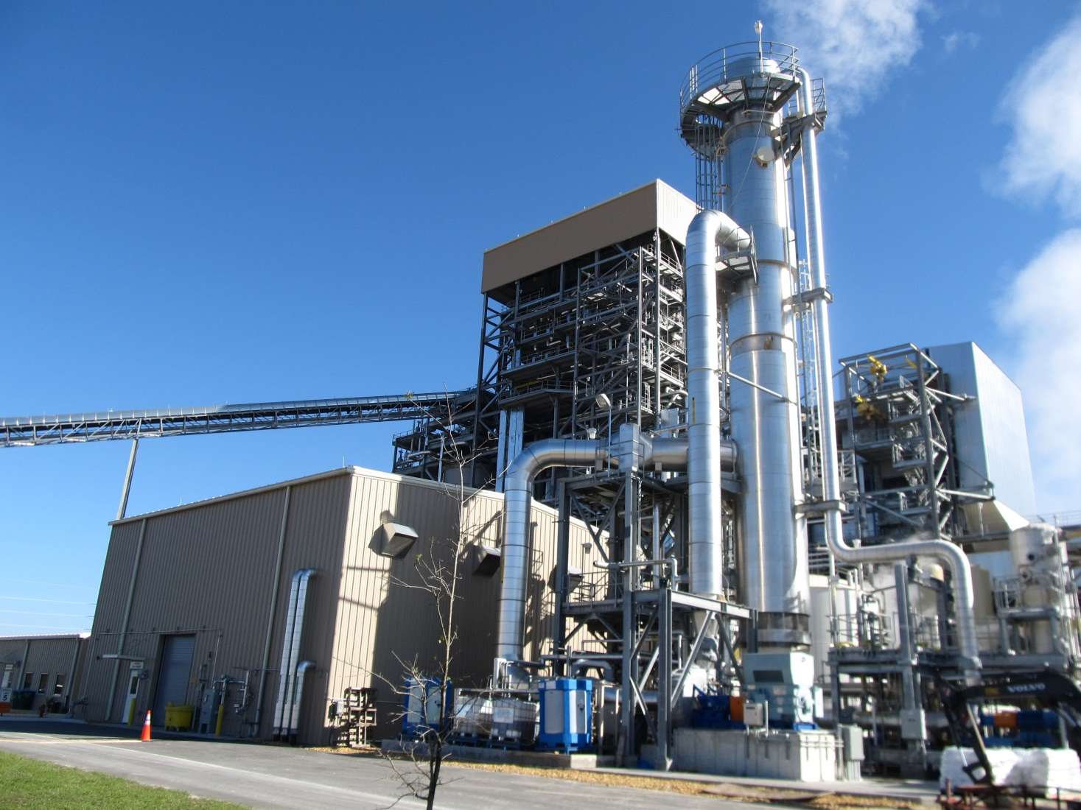
Zero Discharge System

Slide 38
Performance Tests
Overview of Performance Test Results
Continuous Emissions Monitoring System (CEMS)
certification is complete.
Heat Rate Performance Test:
Tested Capacity – 102.5 MW
Tested Heat Rate – 3% below Guarantee
Emission Testing – All Passed

Slide 39
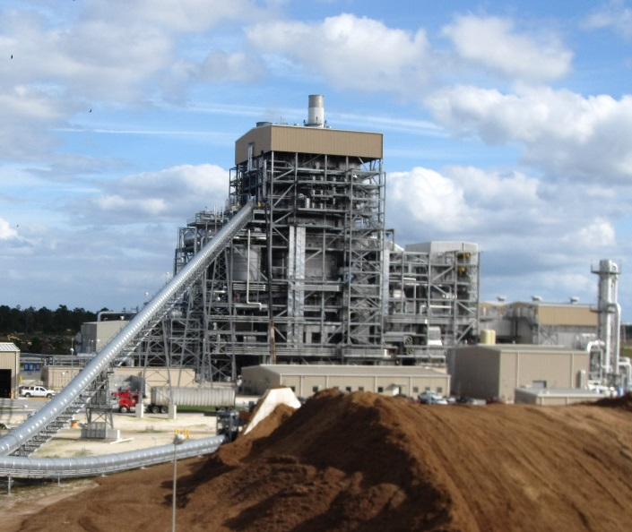
Thank you for your interest. www.gainesvillebiomass.com

